Slide 1
Detailed Tomato leaf disease Detection using Transfer Learning
A024 KUNJ JARIWALA
A041 MEET PATEL
A112 KEVIN MEHTA

Slide 2
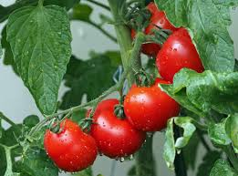
INTRODUCTION
Tomatoes are essential for global food security, but in India, their prices are impacted by disease susceptibility. Traditional manual detection has limitations.
We aim to introduce a Web Application which offers innovative solutions such as automating early detection that helps in enhancing tomato quality by knowing the kind of disease for the tomato plant.
1

Slide 3
Problem Statement
- Tomato industry in India faces challenges with disease management and volatile prices.
- Traditional disease detection methods are labor-intensive, time-consuming, and often ineffective.
- Lack of access to expert agronomists in remote areas compounds the issue.
- So we are aimed at improving tomato leaf production efficiency, food security, and economic prosperity.
2

Slide 4
Literature Survey
Paper | Limitations | Features
A Deep Learning-Based Approach in Classification and Validation of Tomato Leaf Disease using MobileNetV2 (Wagle and H. R.) [1] | - Limited discussion of real-world deployment and challenges. - Generalization to more diseases not explored. | Utilizes deep learning for accurate tomato leaf disease classification. - Addresses the challenge of disease classification, crucial for crop health.
Classification for Tomato Disease with Imbalanced Samples Based on MobileNetV2 (Li, Yin, Wu, Liu) [2] | -Limited explanation of data collection and dataset characteristics. -Limited data. | - Addresses imbalanced datasets using MobileNetV2 and data augmentation. - Enhances classification accuracy, a common issue in machine learning datasets.
Identification System of Tomato Leaf Diseases Based on Optimized MobileNetV2 (Xie et al.)[3] | - Limited discussion of model's scalability for diverse disease types | - Introduces an optimized MobileNetV2 for efficient tomato leaf disease identification.
3

Slide 5
Literature Survey
Paper | Limitations | Features
Tomato Leaf Diseases Classification Based on Leaf Images: A Comparison between Classical Machine Learning and Deep Learning Methods (Tan, Lu, Jiang) [4] | - Limited discussion of specific machine learning algorithms compared. - Doesn't explore challenges in real-world deployment. | - Highlights the superiority of deep learning in tomato disease classification. - Emphasizes choosing the right approach for disease classification in agriculture.
Classification of Tomato Leaf Diseases Using MobileNet v2 (Zaki, Zulkifley, Stofa, Kamari, Mohamed) [5] | - Limited number of diseases considered -limited dataset | -Utilizes MobileNet v2 for the classification of tomato leaf diseases, achieving high accuracy.
4

Slide 6
About the Dataset
Project comprises approximately 30,000 images categorized into 9 distinct classes and 1 healthy tomato leaf classes.
The specific classes within the dataset are as follows:
Early Blight
Late Blight
Septoria Leaf Spot
Bacterial Spot
Spider Mites
Target Spot
Yellow Leaf Curl Virus
Mosaic Virus
Healthy Leaf
5

Slide 7
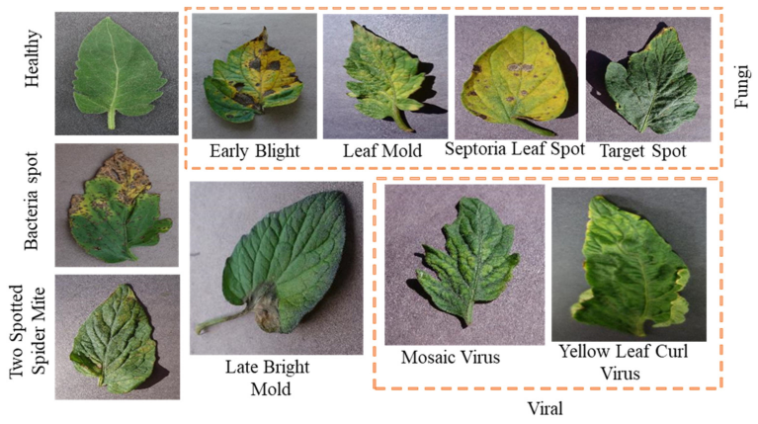
About the Dataset
Dataset Split | Number of Images
Training data | 25,200
validation data | 4,800
Total Result | 30,000
6

Slide 8
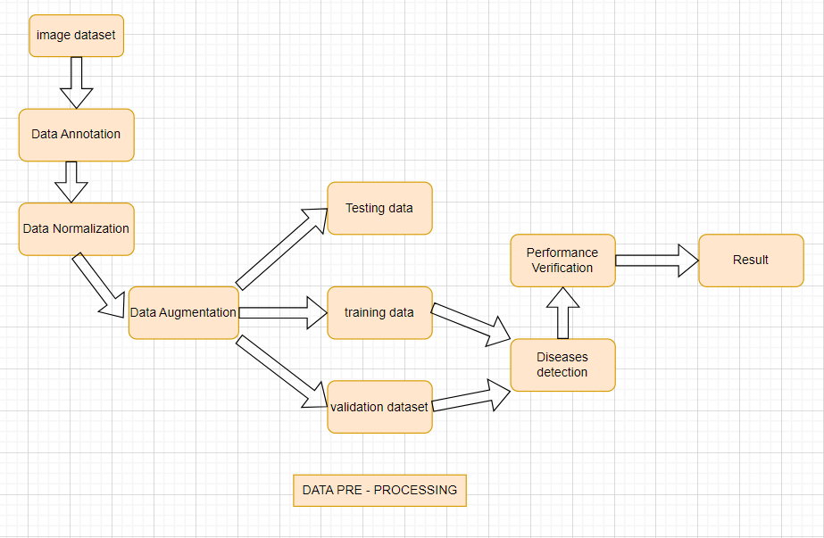
How our image preprocessing works.
7

Slide 9
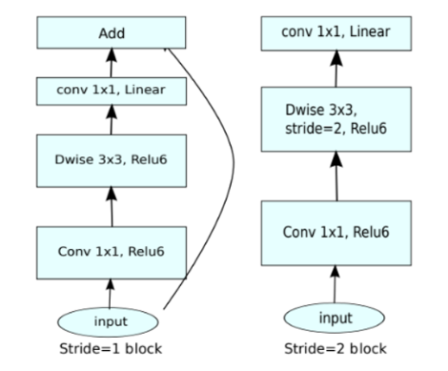
ABOUT THE MODEL
MobileNetV2 architecture consists of multiple layers that work together to efficiently extract features from input images.
Its Architecture is based on an inverted residual structure .
It contains multiple linear bottleneck layers.
It works on 2 concepts:
-Depthwise convolution
-Pointwise convolution
8

Slide 10
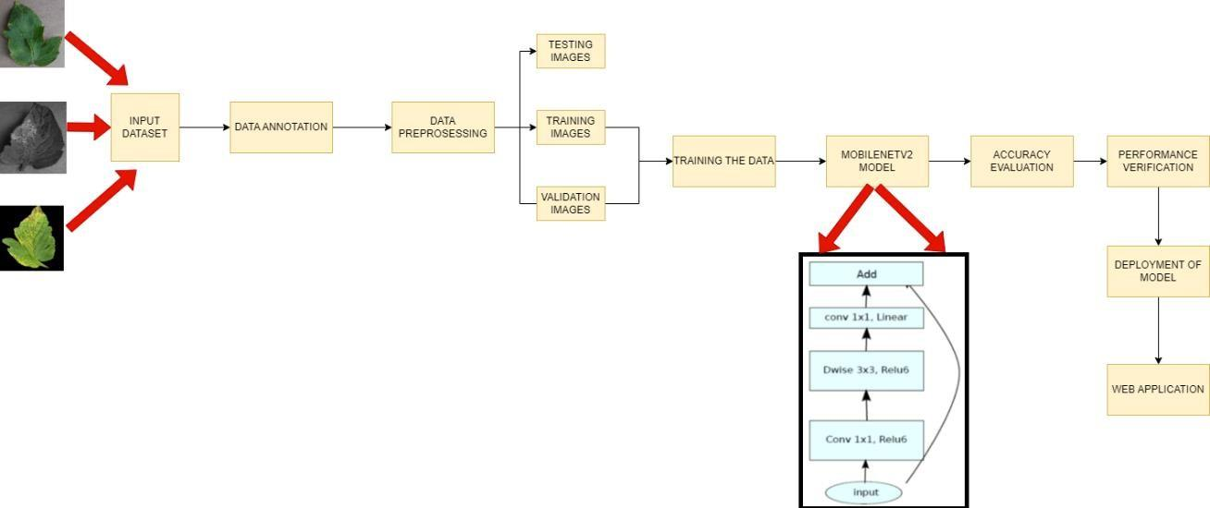
BLOCK DIAGRAM
9

Slide 11

Result and Analysis
We have gained an accuracy of 99.2% with MobilnetV2 model in training phase and 97% accuracy in validation phase.
We implemented a user-friendly web application that allows users to upload multiple tomato leaf images for disease detection at a time.
By leveraging state-of-the-art machine learning and computer vision techniques, we have developed a robust and efficient model capable of identifying diseases in tomato plants that takes input of multiple images and gives a sophisticated description of the disease alongside the healthy ones if not detected.
10

Slide 12
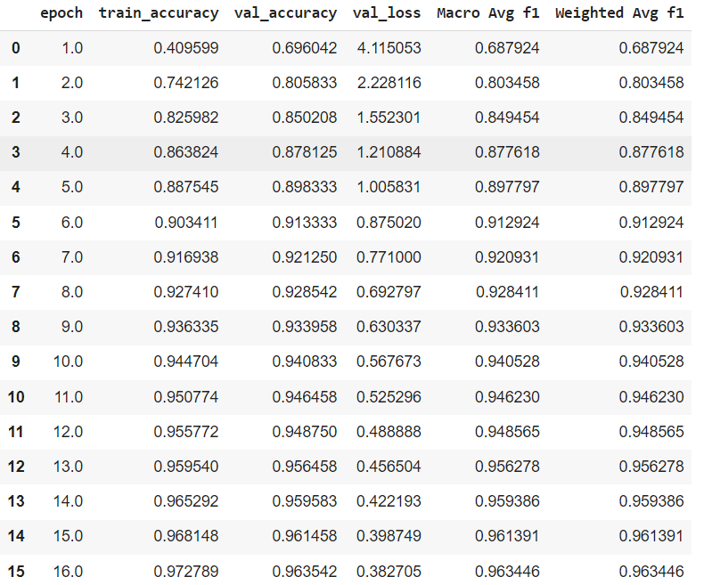
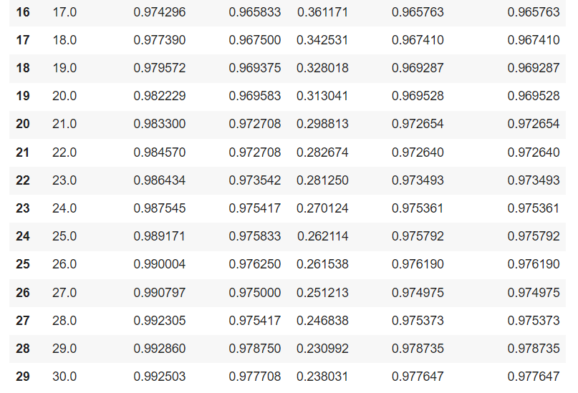
Epoch count - how accuracy increases over count
11

Slide 13
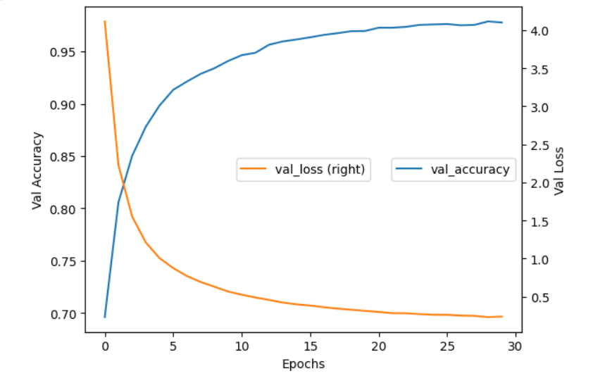
Result and Analysis
The achieved validation accuracy and validation loss
12

Slide 14
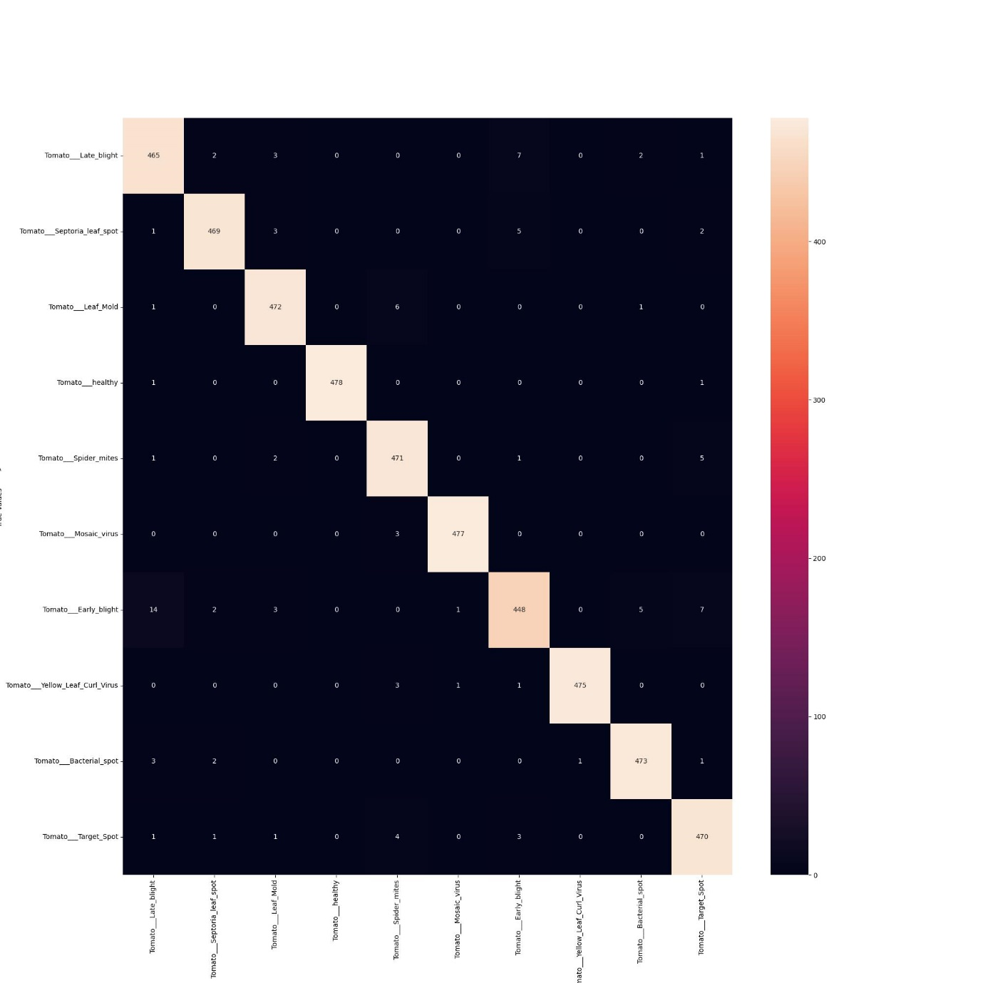
Result and Analysis
Confusion Matrix
13

Slide 15
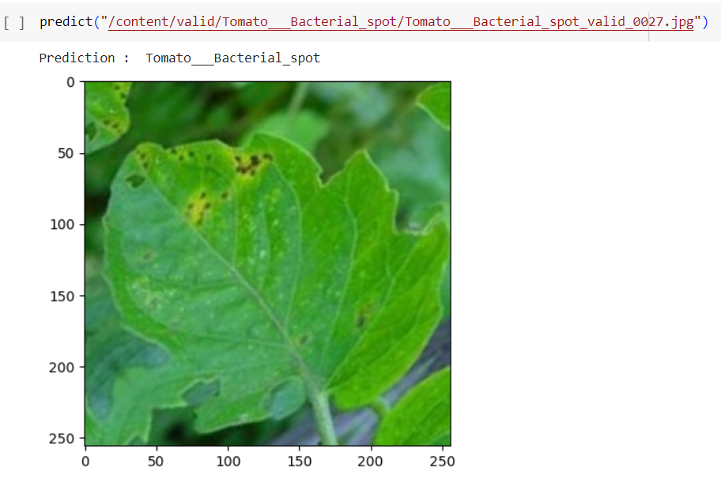
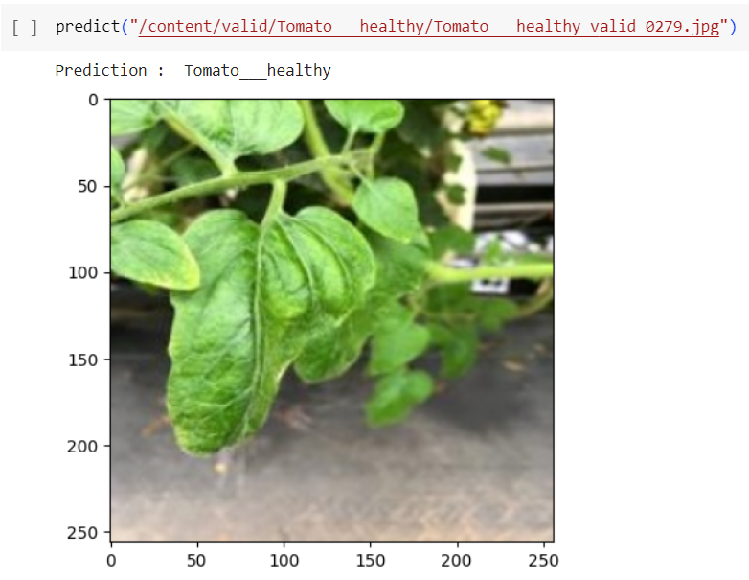
Result and Analysis
14

Slide 16
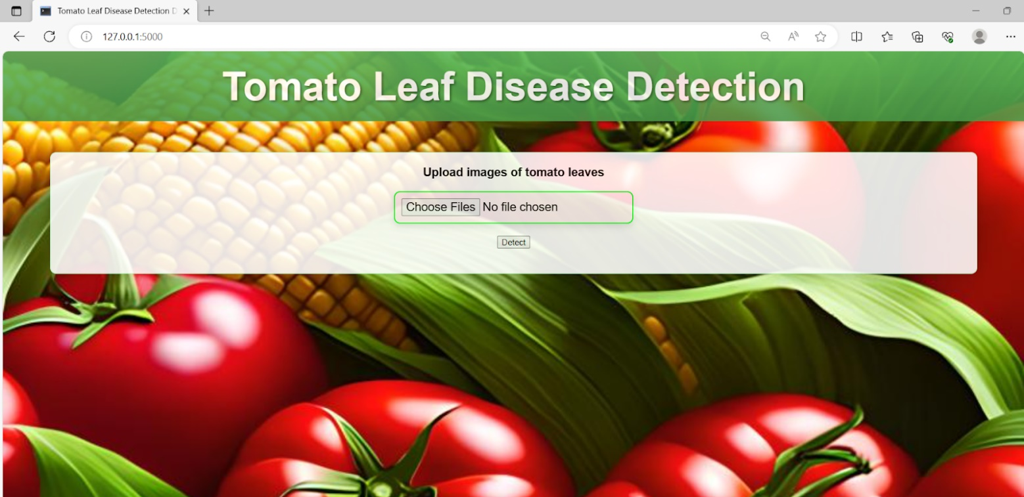
Final Prototype
After clicking on detect the it will give the result as:-
1] Name of Diseases detected
2]Description of diseases that is detected
3]Remedies that can be done to avoid diseases.
15

Slide 17
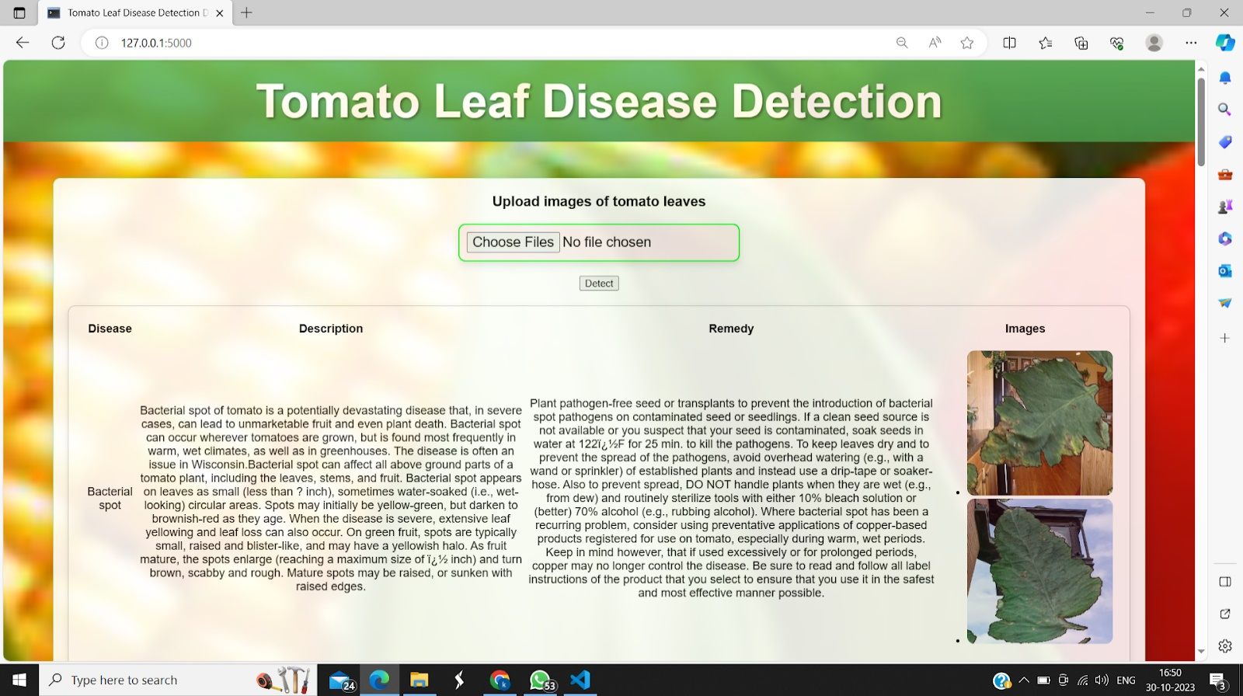
Final Prototype
16

Slide 18
Conclusion and future scope
Our project has delivered exceptional results, achieving 99.2% training phase accuracy and 97% validation phase accuracy using the MobileNetV2 model. We've developed a user-friendly web application for multi-image tomato leaf disease detection, providing comprehensive disease descriptions.
Integration with geopatial data can help farmers and experts to track diseases pattern over larger regions.
In the future, we aim to create a mobile web app for on-the-go disease identification through smartphone image scanning.
17

Slide 19
References [1] Shivali Wagle, Harikrishnan R.: “A Deep Learning-Based Approach in Classification and Validation of Tomato Leaf Disease”, Traitement du signal. 38. pp.699-709, 2021. [2] D. Li, Z. Yin, Z. Wu and Q. Liu, "Classification for Tomato Disease with Imbalanced Samples Based on TD-MobileNetV2," 2021 5th International Conference on Imaging, Signal Processing and Communications (ICISPC), Japan, pp. 35-39, 2021. [3] Shengqiao XIE, Yang BAI, Qilin AN, Jian SONG, Xiuying TANG, Fuxiang XIE, “IDENTIFICATION SYSTEM OF TOMATO LEAF DISEASES BASED ON OPTIMIZED MobileNetV2”, INMATEH - Agricultural Engineering, Vol. 68 Issue 3, pp.589-598. , 2022. [4] Tan L, Lu J, Jiang H., “Tomato Leaf Diseases Classification Based on Leaf Images: A Comparison between Classical Machine Learning and Deep Learning Methods”, AgriEngineering, pp.542-558, 2021. [5] Zaki, S.Z., Zulkifley, M.A., Stofa, M.M., Kamari, N.A., & Mohamed, N.A., “Classification of tomato leaf diseases using MobileNet v2.” IAES International Journal of Artificial Intelligence, 9, pp.290-296., 2020.
18

